Slide 1
Exploring Ethnic Disparities and Trends in Police Stop-and-Searches of England and Wales (2006 – 2023)

Slide 2
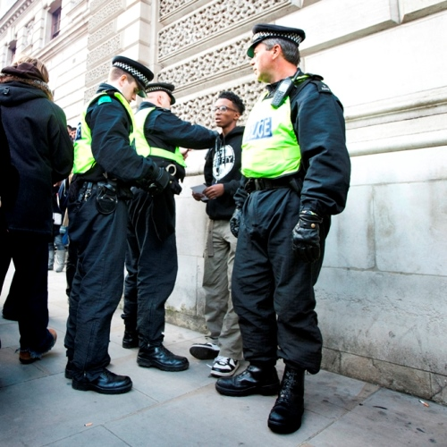
Content
Summary of the Datasets used
Why is understanding police stop and search trends important?
Visualisations and Analysis of the dataset
Critical Evaluation and Challenges
Schmidt, C (2010) https://www.cypnow.co.uk/content/news/met-police-criticised-over-inconsistent-use-of-stop-and-search/
Notes:
Outline of the presentation
Aim of the analysis: To explore the trends in stop and search data of police in England and Wales with a particular focus on ethnicity.

Slide 3


Datasets
- ‘Stop and Search’ Datasets
Containing details of all Police stop and searches in England and Wales
Years covered: 2006-2020, 2021-2023 in 2 datasets
Including demographic information and reasons for stops
Source: GOV.UK ^{[1]}
Supplementary Data
Regional Population Data by Ethnicity
Source: Office for National Statistics ^{[2]}
Used to create maps of regional analysis
Regional Shapefiles
Source: OpenDataSoft ^{[3]}
Provide demographic context for regional comparisons
https://www.standard.co.uk/news/crime/police-in-england-and-wales-to-ramp-up-stop-and-search-in-crackdown-targeting-knife-crime-a3938206.html
Notes:
'Stop and Search’ refers to the police power to be able to stop people and detain them in order to search them.
The datasets were drawn from police records of stop and searches in England and Wales

Slide 4
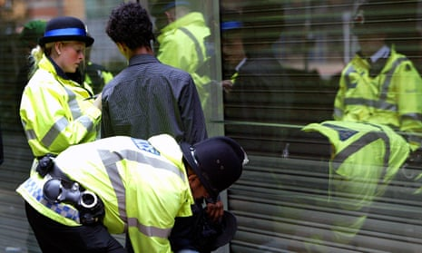
Why is understanding trends in Police Stop and Searches important?
Inform Policy Making
Resource Allocation
Accountability for law enforcement
Addressing disparities in the demographics stopped
https://www.theguardian.com/uk-news/2023/nov/13/england-stop-and-search-does-not-cut-violence-thinktank
Notes:
Understanding the trends in police stop and search data is important for a variety of reasons.
For the government and police force management in cam be used by policymakers to improve regulations in policing practice as well as ensuring that resources are deployed appropriately both geographically but also operationally. This analysis should lead to more effective policing.
Transparency of police stop and search trends also ensures accountability for law enforcement by identifying and hopefully addressing potential biases in policing practices. By demonstrating accountability for these disparities police can also foster more public confidence which is a growing concern as recent studies have shown that only 41% of people in England trusted the police ^{[4]}.

Slide 5
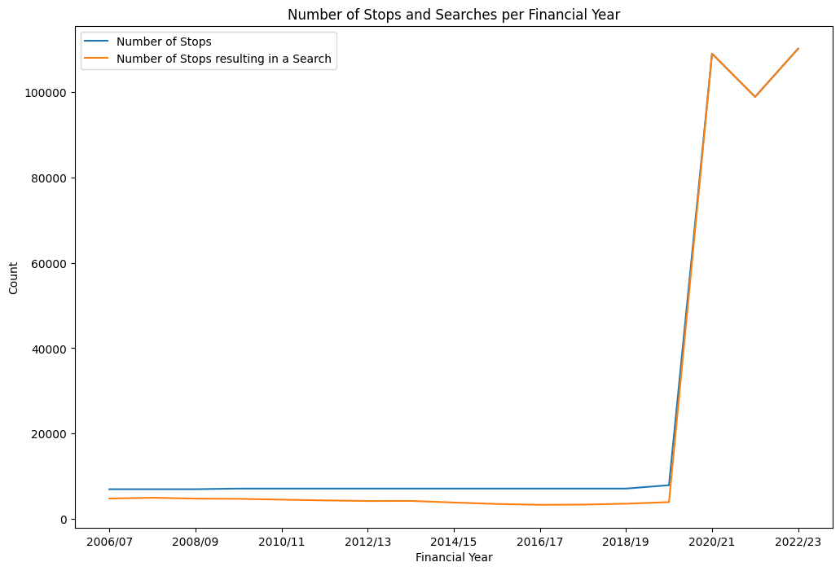
Number of Police Stops over Time
The number of police stops per Financial year
Findings:
Low and stable level from 2006 - 2020
Significant increase in 2020
Causes for increase:
COVID-19 restrictions
Focus on knife crime
Changes in policy (section 60)
Notes:
The data reveals a sharp increase in the number of stop and searches in 2020 with this increase remaining until 2023. This aligns with a number of potential events showing the dynamic nature of this data.
The COVID-19 pandemic may play a role in this increase as lockdown measures led to more street policing. Furthermore, policy changes also occurred in this period with relaxations in the section 60 policing power which empowered police to conduct searches without reasonable suspicion in designated areas. Also linking to this is an increased focus on addressing knife crime which has contributed to heightened police activity and in particular searches to find prohibited items.
The consistency of these high levels of stops since 2020 may suggest that this higher policing level may continue for the foreseeable future.
Furthermore, until 2020 not all stops resulted in a search, with the number of searches consistently lower than the total number of stops. After 2020, almost every recorded stop resulted in a search this possibly suggests a change in reporting practices or perhaps stricter guidelines emphasizing that stops only occur if a search is needed.

Slide 6
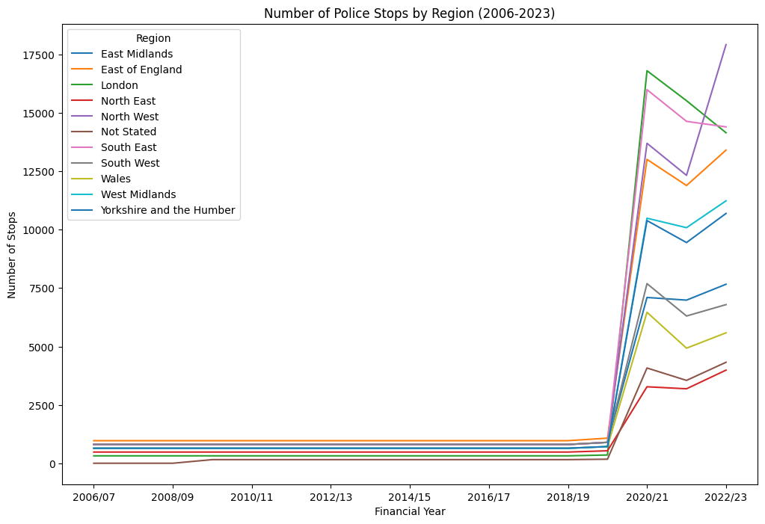
Number of Police Stops by Region
Aim: To determine if the increase in stops is experienced across England and Wales
Findings:
All regions experienced increase in police stops during 2020
North West experienced the largest increase in stops
North East had the smallest increase
Notes:
To determine if this increase was particularly focused to one region a regional plot of this data was created. Although every region of England and Wales experienced this increase the effects can be seen on varying levels.
The North West experienced the largest increases in stops over all suggesting heightened police activity in the area. This is followed by London and the South East which both experienced an increase in 2020 followed by a decline by 2022. The subsequent decline after 2020 could reflect an adjustment in policing post-pandemic.
The smallest increase was experienced by the North East this could be due to the population density or strategic differences in policing due to other priorities.

Slide 7
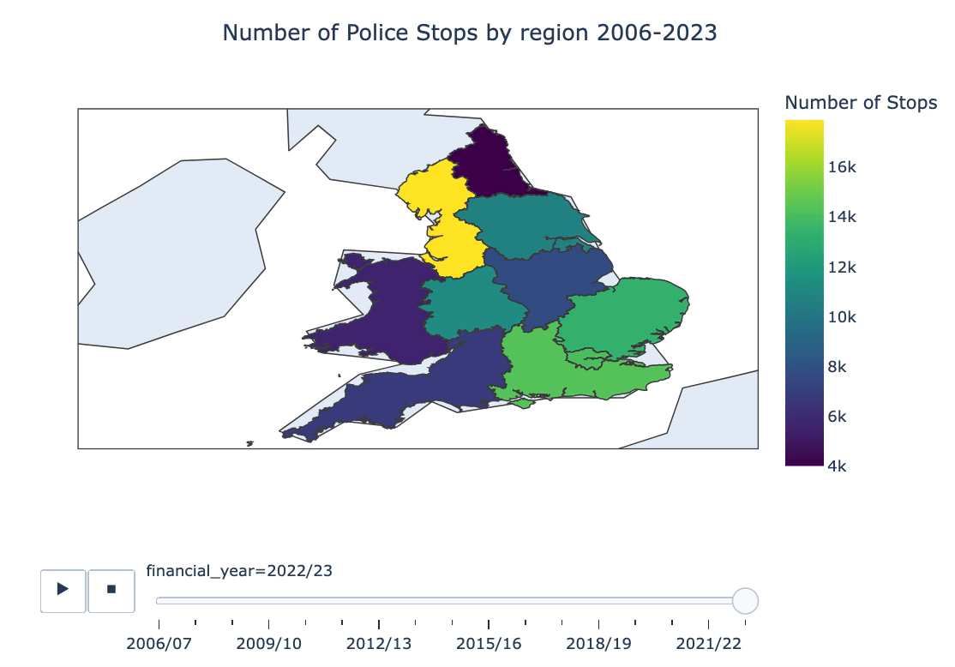
Notes:
This data has been geographically visualised above.

Slide 8
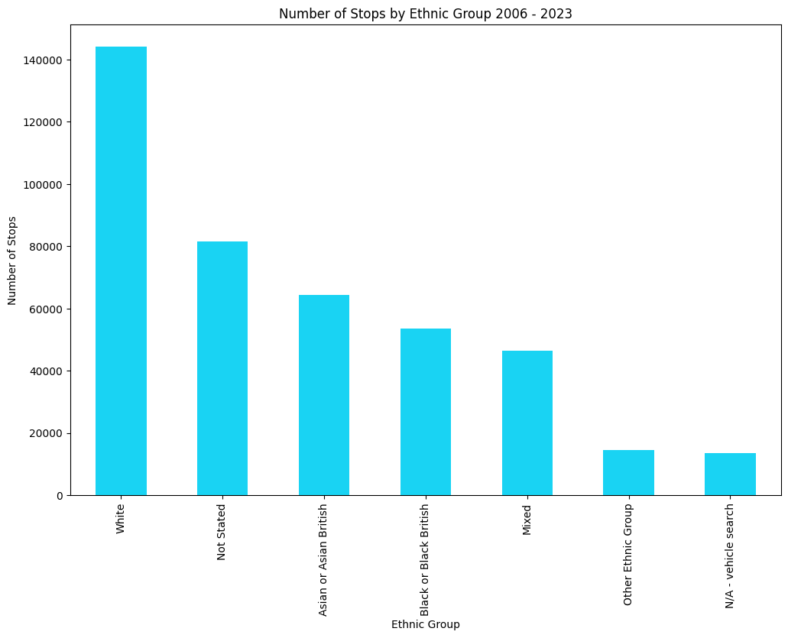
Number of Stops by Ethnic Group
Findings:
Majority of police stops involved individuals stated as White
Not Stated group indicates gaps in data collection and reporting
If no bias is occurring, we would expect this to reflect population demographic
Notes:
To investigate ethnicity trends in Stop and Search data the number of police stops can be broken down by ethnic group.
The data shows that the majority of stops involve white individuals. The next most common is ‘Not Stated’ group indicating a gap in reporting which could impact the analysis.
At first glance, this distribution appears to align with the ethnic composition of the population of England and Wales, with White people making up the largest group. However, to determine if there is evidence of bias in law enforcement’s stop and search practices it is essential to compare these figures to the proportions of these ethnic groups within the populations.

Slide 9
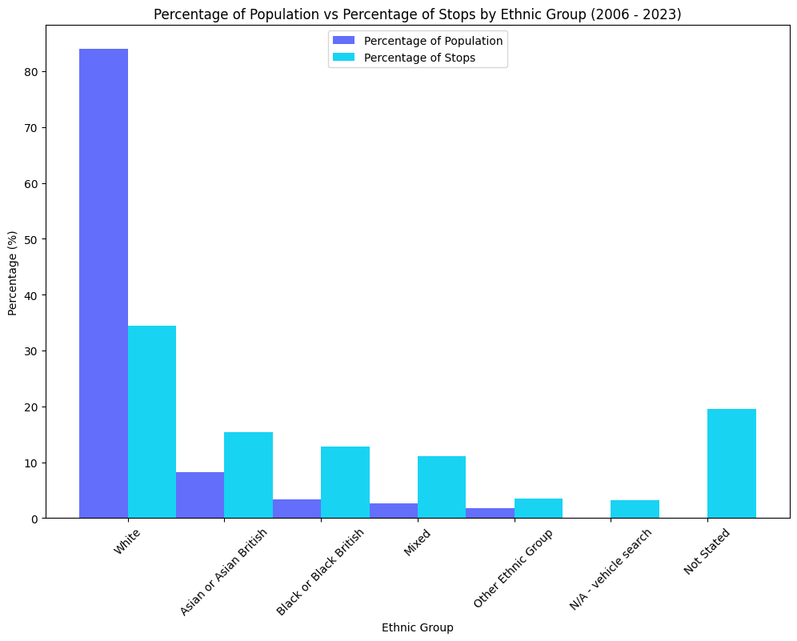
Population and Stop Demographics Comparison
White individuals: Proportion of stops is significantly lower than their population share.
Asian, Black, Mixed and Other Ethnic groups: Disproportionally stopped relative to their population size.
Highlights potential bias in Stop and Search practices.
Notes:
By instead assessing the percentage of the population and percentage of stops by ethnic group comparison a clear disparity in Stop and Search practices can be seen..
While White individuals experience fewer stops than their population share would suggest, every other ethnic group is stopped at a disproportionately higher rate. This disparity is particularly stark for Black individuals who experience this difference at the highest rate.
These findings highlight a potential systemic bias in Stop and Search practices raising questions on the fairness of policing practices.

Slide 10
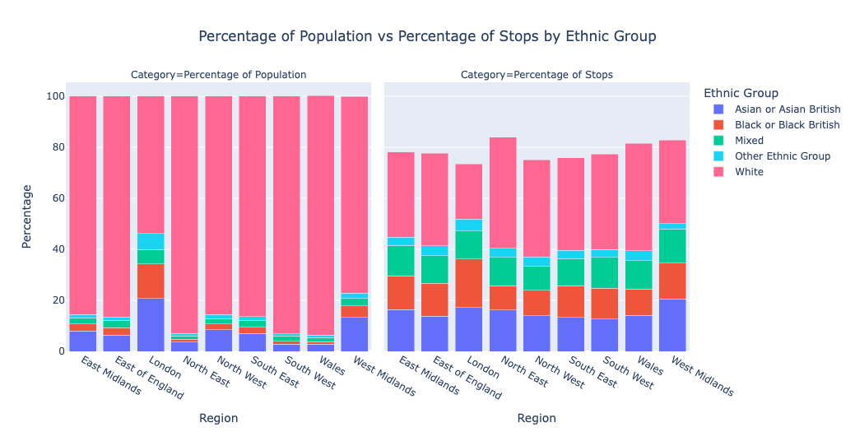
Reginal Ethnic Group Population and Stop Demographics by Region
Disparities in stops by ethnic group are consistent across most regions.
White individuals are underrepresented in stops relative to their population in all regions
London shows the smallest disparity with stop proportions closer to the population demographic
* Not Stated and Vehicle Searches not depicted but included in percentage calculations
Notes:
In order to understand if these Ethnic disparities are a systemic issue or a weakness of a particular area the data can be broken up regionally.
Across all regions white individuals are underrepresented in stops relative to their population, while other ethnic groups are disproportionately represented. London shows the smallest disparity with the stop proportions more closely aligned with the population demographics. This, however, raises questions on if this reflects a difference in policing practices or if it is due to the city’s unique, more diverse population.
This highlights a consistent systemic bias across most of England and Wales and suggests a need for further investigation into the factors driving this disparity.

Slide 11
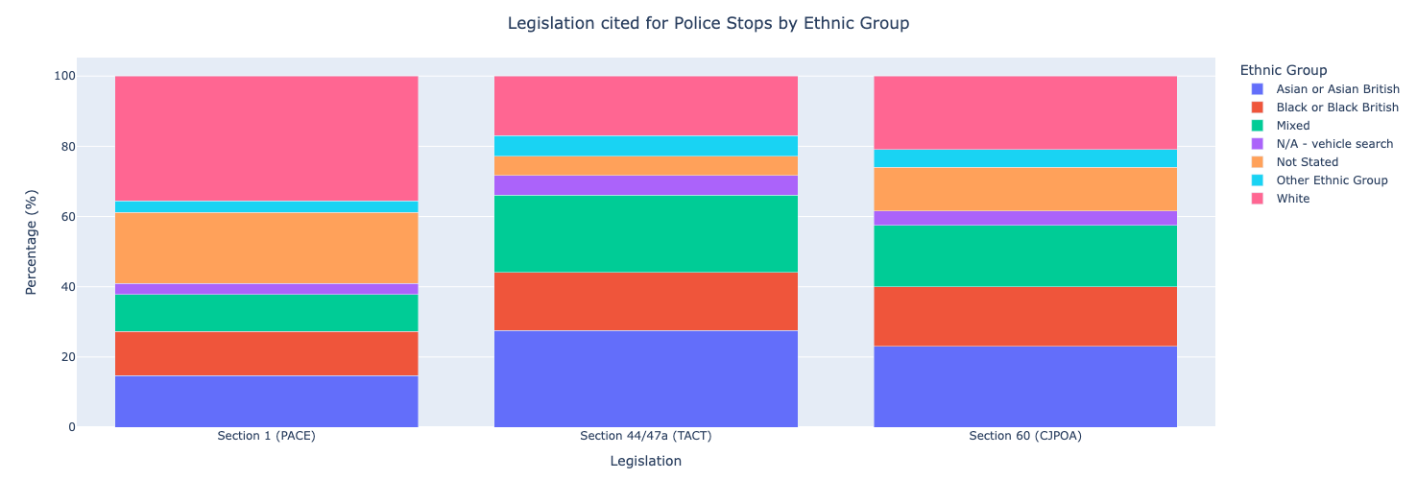
Legislation and Ethnicity
Section 1 (PACE):
- reasonable grounds to suspect they will find prohibited items.
Section 44/47a (TACT):
- reasonable suspicion that an act of terrorism will take place.
Section 60 (CJPOA):
individuals for weapons or dangerous instruments,
authorisation must have been granted
- no need for suspicion
Notes:
By examining the legislation cited during police stops by ethnic group variations in their applications can also be seen.
Section 1 of PACE: This is the most common legislation cited for stops and is used when there are reasonable ground to suspect prohibited items are in possession. White individuals comprise the largest proportion (35.5%). However, 20% of cases lack a stated ethnic group and remaining proportions are split relatively evenly between the remaining ethnic groups.
Section 44/47a of TACT: Demonstrates a significant overrepresentation of ethnic minorities, particularly Asian or Asian British individuals (27.5%). This suggests that anti-terrorism legislation disproportionately targets non-White groups.
Section 60 of CJPOA: Although this legislation is more evenly distributed the data still reflects a trend that this legislation is more likely to be used on ethnic minorities than White individuals.
These disparities across the legislations, raise questions about the fair application of legislative powers and potential biases of their use in policing.

Slide 12
Critical Evaluation and Challenges encountered
Challenges encountered:
Using Git
Managing git commit history effectively
Branches were unnecessary for this project
Some technical difficulties with Google Colab and GitHub interactions
Handling missing data
Choosing appropriate data analysis and visualisations
Ensuring code was efficient and well commented
Opportunities for Improvement and Limitations:
Population data including demographics was focused on the year 2021 rather than the whole period leading to some inaccuracy
Improvement: Use demographic and population data yearly to build a picture of how this changes
More Statistical Analysis
Notes:
The main challenge I encountered was using Git effectively to track the development of my code as this was my first time doing this independently for a project. I found this particularly challenging as I encountered some technical difficulties in using Google Colab for my coding and the interactions it had with GitHub.
In my project I also had to choose appropriate data analysis and visualisations. Using a large dataset, meant I had to choose a topic to focus on and narrow down the data. For this I chose to particularly prioritise ethnicity.
If I had more time and access to other datasets I would like to map the ethnic demographics of the population over time. The data I used focused on census data from 2021 so in my comparisons this can only be used as an estimate. It would be more accurate to find yearly data and compare the ethnic distributions of stops for each year.

Slide 13
References
https://assets.publishing.service.gov.uk/media/618d4e33e90e070445fd7518/stop-search-open-data-tables-ppp-mar2020.ods/preview
https://www.ethnicity-facts-figures.service.gov.uk/uk-population-by-ethnicity/national-and-regional-populations/population-of-england-and-wales/latest/downloads/population-of-england-and-wales.csv
https://public.opendatasoft.com/explore/dataset/georef-united-kingdom-region/export/?disjunctive.ctry_code&disjunctive.ctry_name&disjunctive.rgn_code&disjunctive.rgn_name
Pickering, S., Dorussen, H., Hansen, M. E., Reifler, J., Scotto, T., Sunahara, Y., & Yen, D. (2024). London, you have a problem with women: trust towards the police in England. Policing and Society, 34(8), 747–762.

